Slide 1

Studies at the
Applied Linguistics Programme of
the Doctoral School of Linguistics
Introduction
2025

Slide 2
Study structure in the doctoral school
4 years = 8 semesters, 240 credits to collect
(152 coursework+consultations, 88 research and publication)
Two phases:
Semesters 1-4: course work and research
  Courses + consultation + research
  At the end of Semester 4: Complex Examination (CE)
  Collect all your course credits before the CE (except elective courses)
Semesters 5-8: research and dissertation
  Consultation + research + writing your dissertation
  You may take elective courses also in this phase
  At the end of Semester 8 (or earlier): submit your dissertation
  (with the defence procedure to follow after that)

Slide 3
Course work in Semesters 1-4
Sem. | Compulsory courses | Consultations | Elective courses
1 | 4 courses, 8 credits each | Weekly/biweekly, 5 cr. | Altogether 4 elective courses, 8 credits each
2 | 4 courses, 8 credits each | Weekly/biweekly, 5 cr.
3 | 1 course, 8 credits | Weekly/biweekly, 5 cr.
4 | 1 course, 8 credits | Weekly/biweekly, 5 cr.
Sum | 80 credits | 20 credits | 32 credits
Compulsory course types:
General: IntroAppling, Academic English (Semester 1), Syntax, Phonology (Semesters 1 or 2)
Research Methods 1 & 2 (Semesters 2, 3): qualitative, quantitative
Research Skills 1 & 2 (Semesters 2, 4)
Compulsory electives A (take two): IntroLangPed, Psycholing1, Socioling1, Pragmatics1, IntroLangTech (in Semesters 1 and 2)
Compulsory electives B: Morphology OR Semantics

Slide 4
The complex examination
At the end of Semester 4
Oral exam
Two parts:
Theoretical part, 2 topics
Dissertation part: research plan presented and defended
See the Programme plan for further details.

Slide 5
Research and publication
At least 88 credits to collect in Semesters 1-8.
Credit possibilities:
Academic publications (min. three academic papers are expected)
Academic talks
Talks at the workshop conferences of the doctoral school (held at the end of each semester)
Other similar activities
Teaching/teaching assistance
See the Programme plan for further details.

Slide 6
Structure of this semester
Course registration period till 14:00 September 12 – tomorrow!
(through Neptun)
Study period this semester: September 8 – December 12
No classes:
  October 23–24, Thursday-Friday (national holiday)
  October 27–November 2 (autumn break)
Exam registration period starts on November 28
Exam period: December 15–January 31

Slide 7
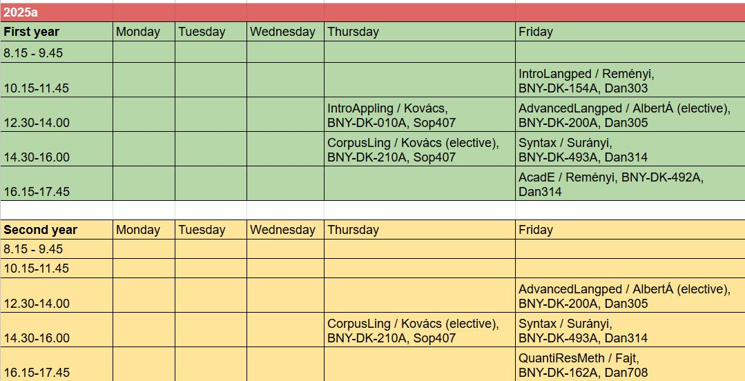
Your weekly timetable this semester

Slide 8
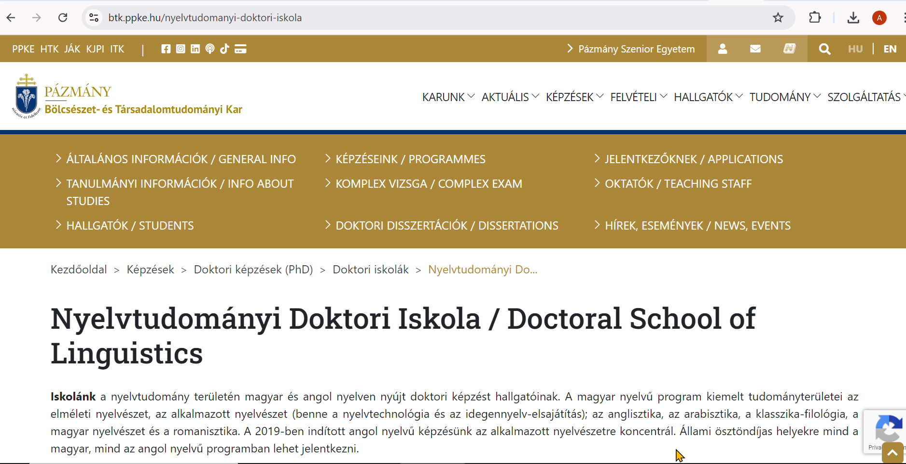
About the Doctoral School of Linguistics
Two programmes:
Theoretical linguistics (in Hungarian)
Applied linguistics (in English)
https://btk.ppke.hu/nydi-applied-linguistics
More about the school: https://btk.ppke.hu/nyelvtudomanyi-doktori-iskola

